Slide 1
FPGA Basic Verilog Programming
Completed basic Verilog programming tasks on Vivado

Slide 2
The Following targets have been completed on Verilog
Understood various combinational logic circuits
Completed ‘Hello’ display in TCL Console
Implemented D Flip-Flop
Implemented Comparator
Implemented 4:1 Multiplexer (Both Hardcoded and Variable inputs)

Slide 3
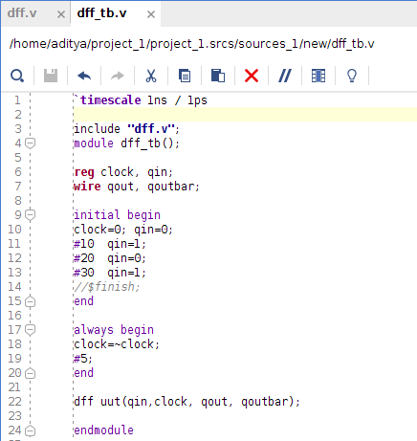
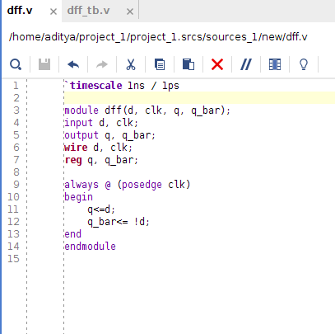
D Flip-Flop
Design Sources
Simulation Sources

Slide 4
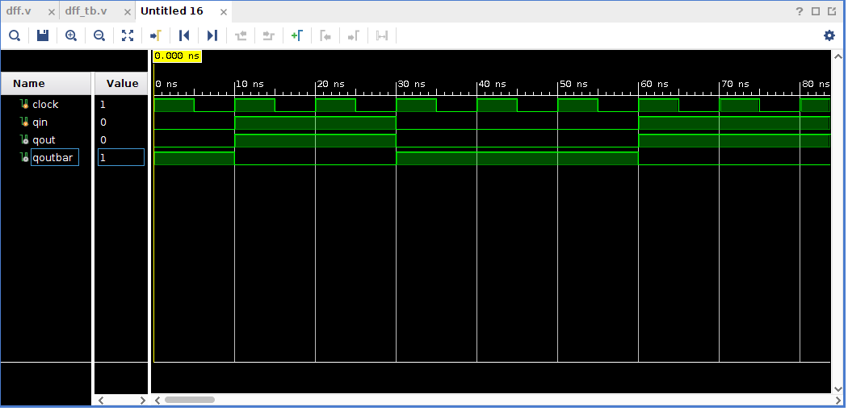
D Flip-Flop Simulation Timing

Slide 5
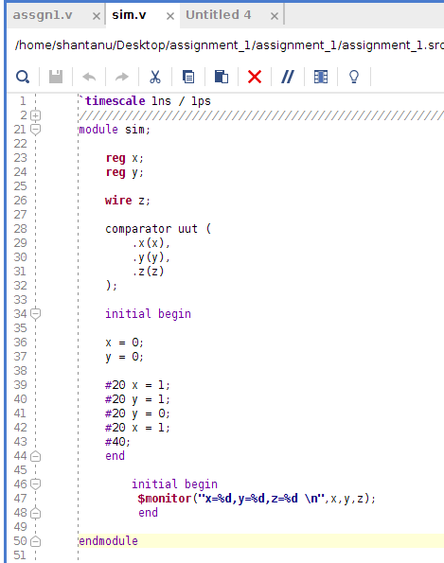
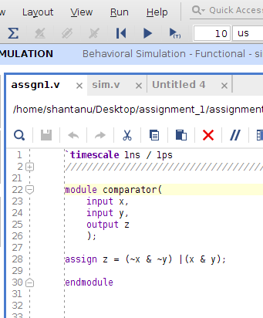
Comparator
Design Sources
Simulation Sources

Slide 6
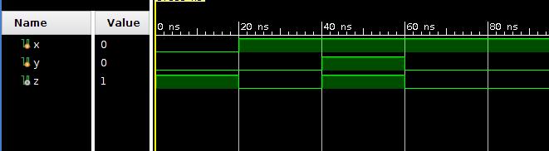
Comparator Simulation Timing

Slide 7
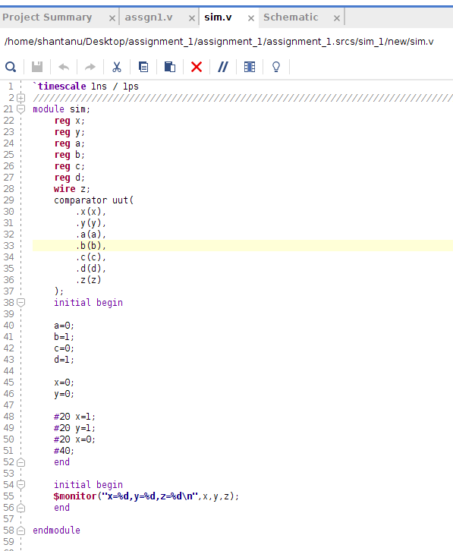
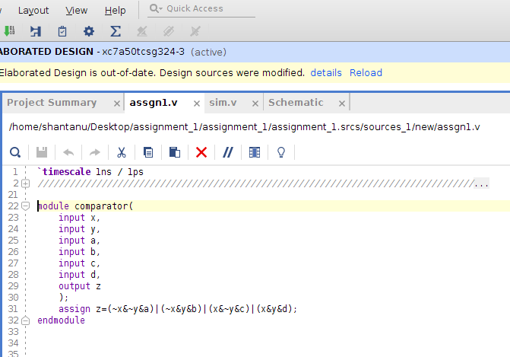
MUX 4:1 (With Hardcoded Inputs)
Design Sources
Simulation Sources

Slide 8
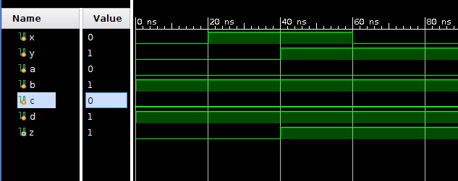
MUX 4:1 (With Hardcoded Inputs) Simulation Timing
Description:
x, y: Selection line for the MUX
a, b, c, d : All inputs for the FPGA
z : Output Signal

Slide 9
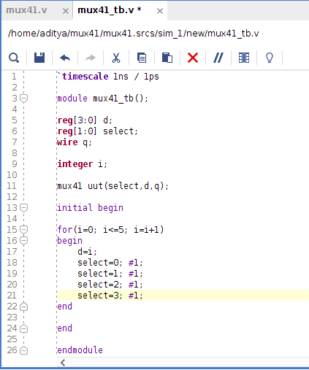
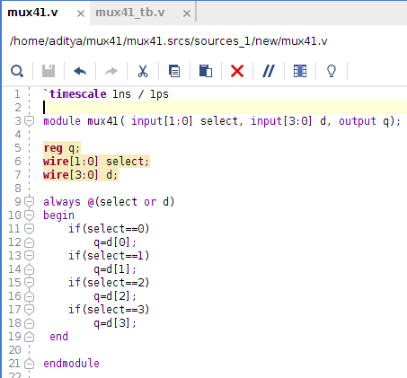
MUX 4:1 (With input signals)
Design Sources
Simulation Sources

Slide 10
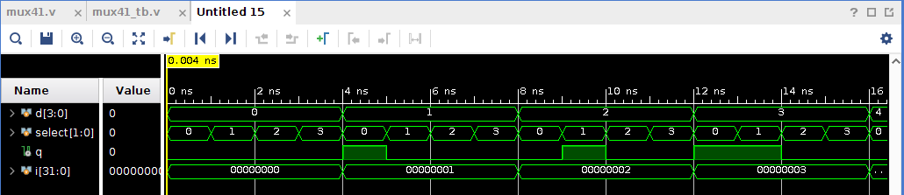
MUX 4:1 (With Hardcoded Inputs) Simulation Timing
Description:
select[1:0]: Selection line for the MUX
d[3:0]: All inputs for the FPGA
q : Output Signal

